Slide 1
NC State Foundation Board Meeting
12 September 2013
Gary M. Scott
SUNY-ESF
Department of Paper and Bioprocess Engineering

Slide 2
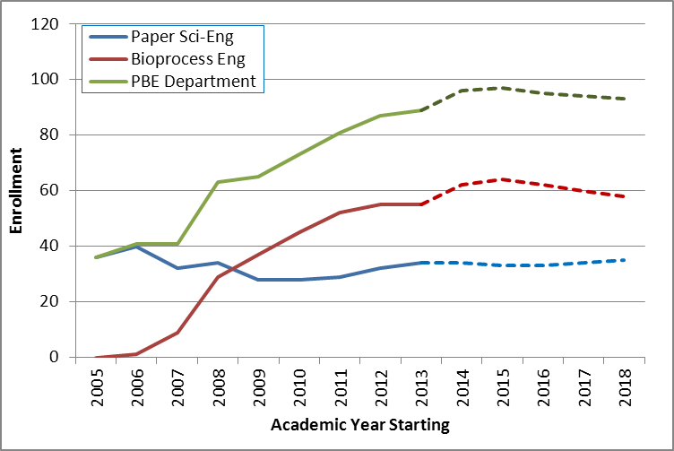
Current Educational Programs
B.S.
Bioprocess Engineering
Paper Engineering
Paper Science
MPS
Paper and Bioprocess Engineering
MS & PhD
Paper and Bioprocess Engineering

Slide 3
Current Educational Programs Undergraduate Accreditation
Paper Engineering
Under ABET/EAC General Engineering criteria
Bioprocess Engineering
Under ABET/EAC Chemical Engineering criteria
Paper Science
Not externally accredited

Slide 4
Addressing Costs
Department of Paper and Bioprocess Engineering
4
Tuition is rising slowing over the next 3 years
$300/yr increase
Scholarship levels are determined by number of students and available funds from the endowment
Available funds are still 4% of a five-year average

Slide 5
Reaching Alumni and Corporations
We could do better
Just starting to use social media
Facebook
LinkedIn
Blogs
Plan for this year to contact “Bioprocess Engineering” companies with program information

Slide 6
Strengths and Opportunities
Looking for growth in the MPS program
Non-thesis masters
College has incentives to bring in self-paying graduate students
Recruiting students outside the department that are finishing their BS degree (and can’t find a job in their major)
Student Recruiting
Working with college admissions
Engineering and job fairs

Slide 7
Future Challenges and Opportunities
Funding at all levels
Institutional support of programs
Student enrollment increases may squeeze scholarship money
Research support
Attracting students
High school students do not understand engineering programs, especially the “different” ones
System-wide mandates
Credit-hour limits
“Seamless” transfer policies

