Slide 1
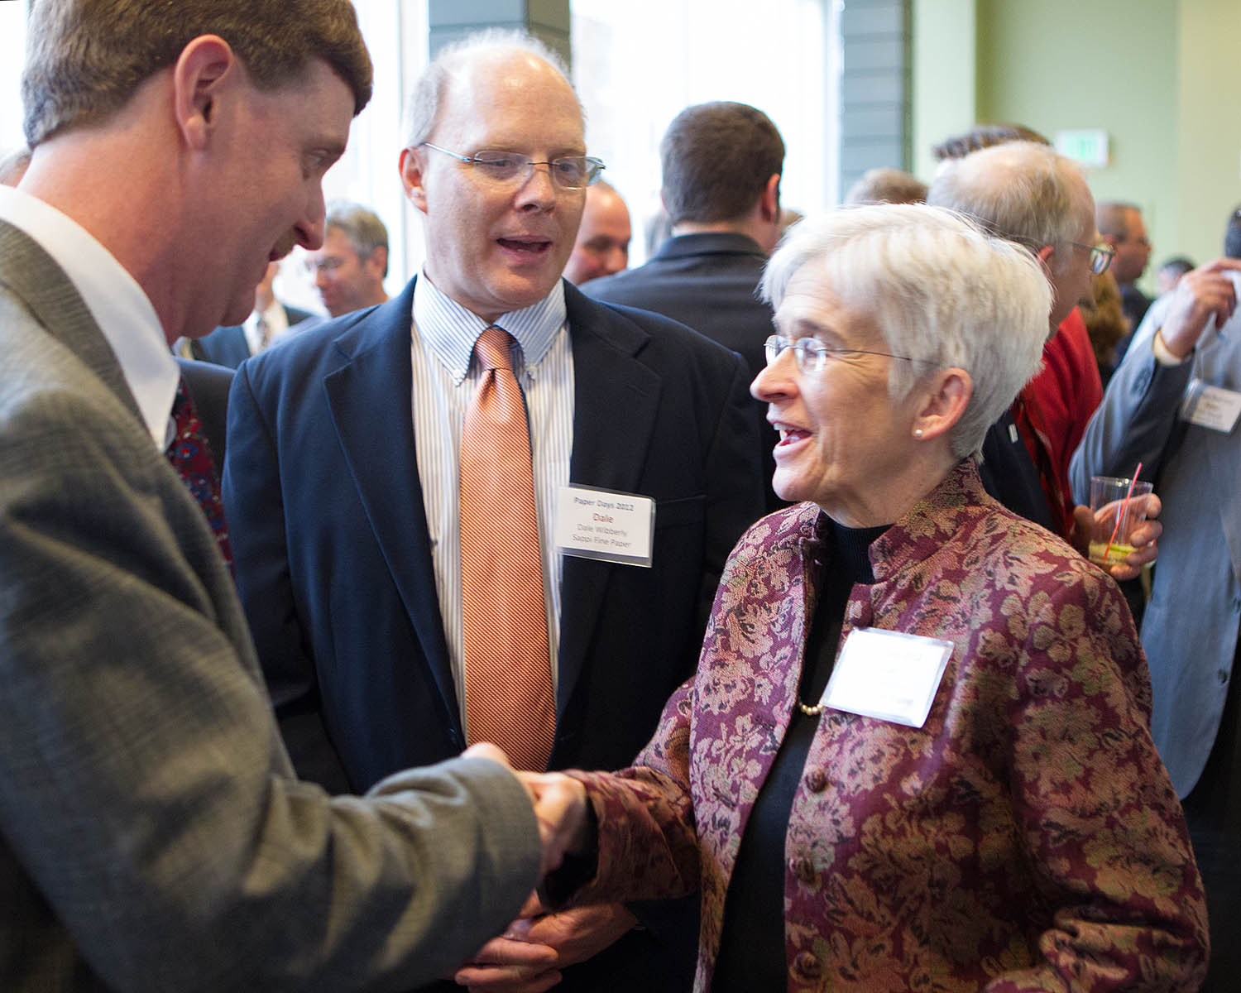
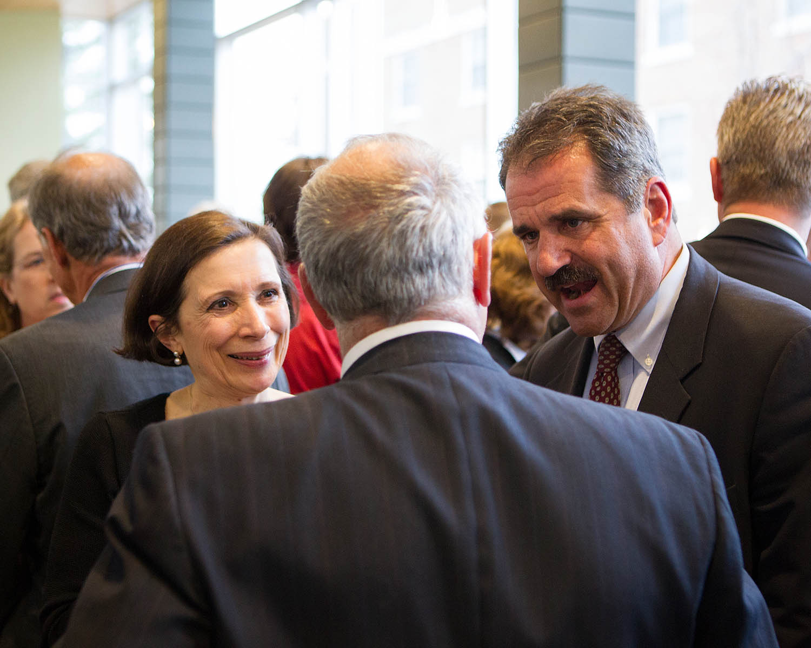
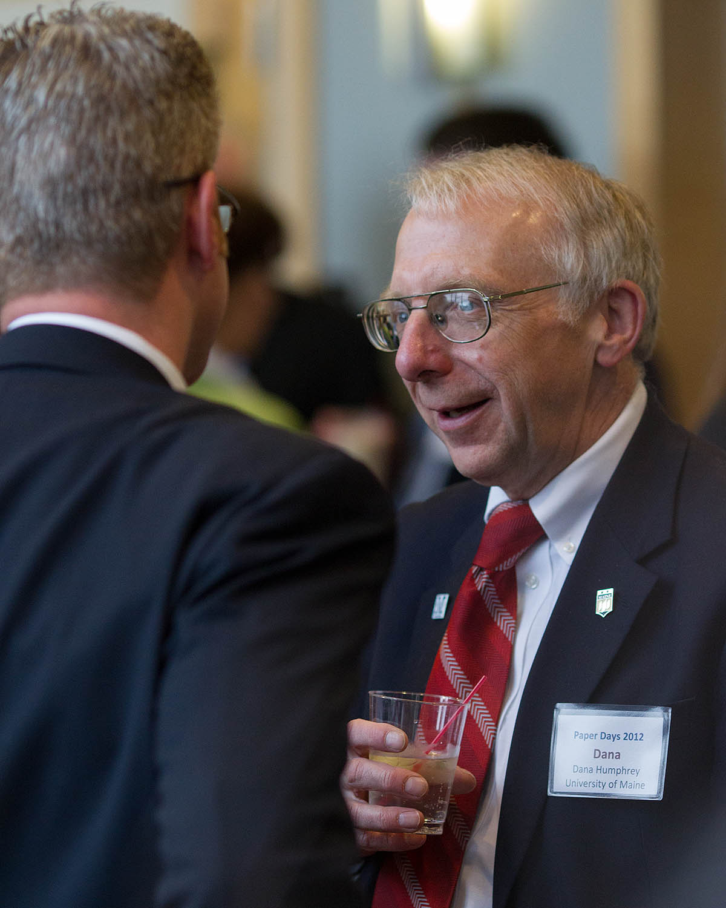
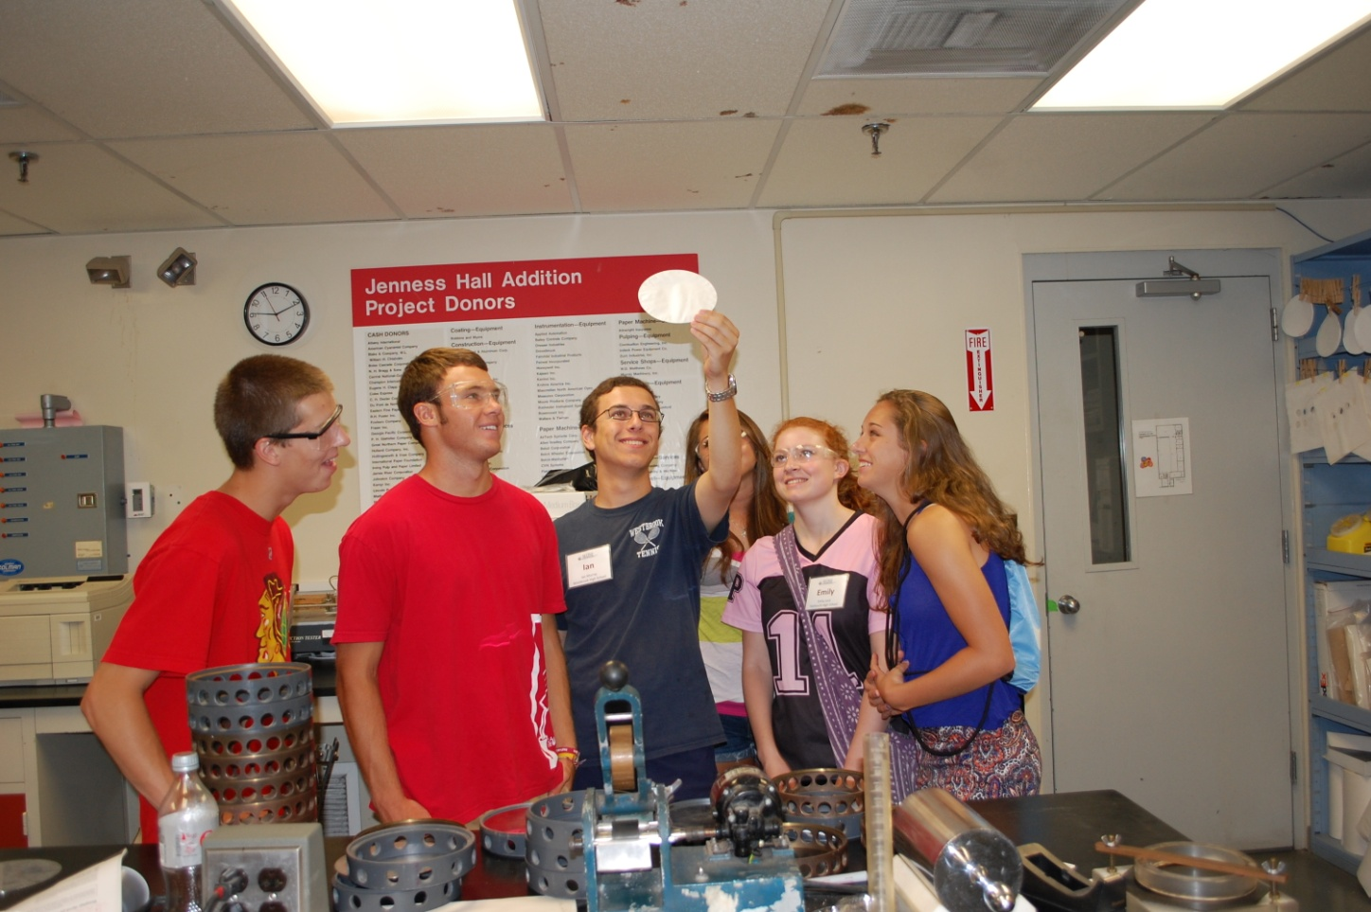
A True Partnership serving the University, the Pulp and Paper Industry, and Students by providing a constant supply of Top Quality Engineers to the Pulp and Paper Industry and its Suppliers
DONORS ● STUDENTS ● INDUSTRY ● UMAINE
DONORS STUDENTS P&P INDUSTRY UNIVERSITY
Opportunity to Give Back
A Way to Say Thank You
Lifetime Foundation Membership
Mentor and Communicate
with Students
Yearly Thank You From
Your Student
Create a Lasting Tribute with an
Endowed Gift
Memorial
Honor a Loved One
Honor a Professor
Say Thank You for a Career
Consider Engineering
Scholarships
Chinn Seminars
Networking
Resume Visibility
Career Placement
Career and Resume’ Help
Co-ops/Internships
Experience
Built in References
Enhanced Resume’
Recognition & Visibility
Networking
One Stop University Access
Access to Research
Access to Technology
Exclusive Resume Access
A Supply of Engineers with:
Top Grades
Leadership Skills
Communication Skills
Co-op/Intern Experience
Scholarships
Networking
Recruitment
ABET Support
Curriculum Guidance
Support for Maine’s
Economy
Financial Support For
Professors
Computers
Grad Students
Consider Engineering – Scholarships - Paper Days - Chinn Seminars - Co-op/Internships

Slide 4
# of 1st year PPF Scholarship Applicants

Slide 5
Key Project/Events/Activities
Fall Scholarship Banquet – Industry members hand our the checks to co-op students
Scholarship selection – industry panel interview chose High school seniors via SKYPE
Paper Days event – 360 attend
Industry Representatives attend HS awards ceremonies to award scholarships
Mini Paper Days event at a mill location
Consider Engineering – 102 students attend UMaine for 4 days

Slide 6
Other Recent Activities
Hired ½ time fund Raiser
Started $2,000,000 endowment campaign
Changed financial manager
Modified scholarship from full tuition to 4 scholarships at full tuition and 20-24 scholarships at $3,500/semester
Completed 5 year strategic plan – will vote changes in bylaws shortly as a result.

Slide 7
The Future
A changing industry with a continuing need for quality engineers.

