Slide 1


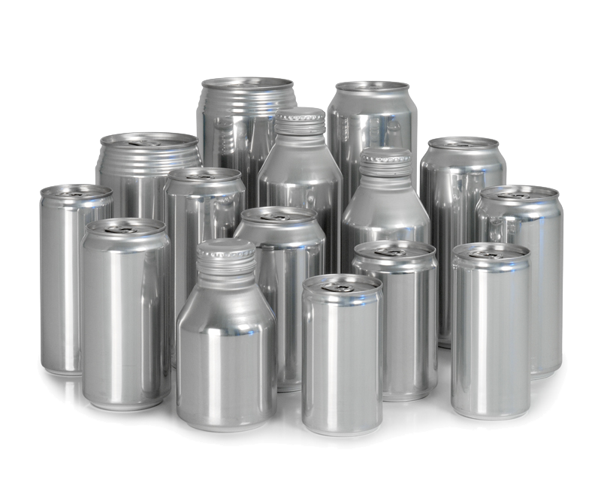
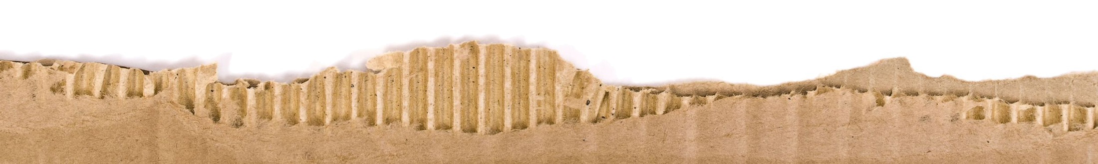
September 11, 2013
Paper & Packaging
Chip Dillon, CFA
Partner
Phone: (212) 257-6159
Fax: (203) 276-5699
cd@verticalresearchpartners.com
James Armstrong
Analyst
Phone: (212) 257-6157
Fax: (203) 276-5699
ja@verticalresearchpartners.com
Anna DeGregorio
Executive Assistant
Phone: (212) 257-6158
Fax: (203) 276-5699
ad@verticalresearchpartners.com

Slide 2
Disclosures
Analyst Certification
Vertical Research Partners analyst(s) whose name(s) appears on the front page of this research report hereby certifies that the recommendations and opinions expressed in the research report accurately reflect the research analyst's personal views about any and all of the subject securities or issues discussed herein.
Transacting Disclosures
Vertical Research Partners is not a broker dealer, so does not trade or carry proprietary positions with firm capital in any covered or other stocks. We have fully flexible payment mechanisms available to our institutional clients, including CSA and CCAs in place with all larger broker dealers and execution-only firms in the US.
Employees and partners of Vertical Research Partners LLC may from time to time, own beneficial positions in securities we publish on. Vertical Research Partners' employees and partners are prohibited from transacting in such securities within 48 hours of a change in recommendation. All employee and partner transactions in covered securities are required to be pre-approved and monitored by VRP LLC.
Other Disclosures
Although the information contained herein has been obtained from sources we believe to be reliable, the accuracy and completeness of such information and the opinions expressed herein cannot be guaranteed. The information and opinions contained herein are subject to change without notice, and Vertical Research Partners, LLC assumes no responsibility to update or amend any information or opinions contained herein. Copyright 2012 Vertical Research Partners, LLC. All rights reserved. All material presented in this document, unless specifically indicated otherwise, is under copyright to Vertical Research Partners, LLC. None of the material, nor its content, nor any copy of it, may be altered in any way, or transmitted to or distributed to any other party, without the prior express written permission of Vertical Research Partners, LLC. This report is limited for the sole use of clients of Vertical Research Partners, LLC. Authorized users have received an encryption decoder with regulates and monitors the access to Vertical Research Partners content. Any distribution of the content produced by Vertical Research Partners, LLC will violate the understanding of the terms of our relationship. The content of Vertical Research Partners website and reports is provided as general and impersonalized investment information and commentary does not constitute a specific recommendation or solicitation that you should purchase or sell any particular security or investment advisory services. Vertical Research Partners is not responsible for trades executed by subscribers to its content. Third-party data providers make no warranties or representations of any kind relating to the accuracy, completeness, or timeliness of the data they provide and shall not have liability for any damages of any kind relating to such data. Vertical Research Partners, LLC does not provide individually tailored investment advice. Vertical Research Partners’ research has been prepared without regard to the individual financial circumstances and objectives of persons who receive it. The securities/instruments discussed in Vertical Research Partners’ research may not be suitable for all investors. Vertical Research Partners, LLC recommends that investors independently evaluate particular investments and strategies, and encourages investors to seek the advice of a financial adviser. The appropriateness of a particular investment or strategy will depend on an investor’s individual circumstances and objectives. The securities, instruments or strategies discussed in Vertical Research Partners, LLC reports may not be suitable for all investors.

Slide 3

N.C. State University
Pulp and Paper Foundation
September 12, 2013
Where Will the Best Returns Be Found in Paper and Forest Products?

Slide 4

The VRP Team
Page 4

Slide 5
Coverage List
Chip Dillon
Kimberly-Clark (KMB)
MeadWestvaco (MWV)
Packaging Corp (PKG)
Sealed Air (SEE)
Silgan Holdings (SLGN)
Rayonier (RYN)
Rock-Tenn (RKT)
Aptar (ATR)
Sonoco (SON)
Weyerhaeuser (WY)
Potlatch (PCH)
Plum Creek Timber (PCL)
Owens-Illinois (OI)
Louisiana-Pacific (LPX)
International Paper (IP)
Domtar (UFS)
Crown Holdings (CCK)
Bemis (BMS)
Ball Corp (BLL)
James Armstrong
PH Glatfelter (GLT)
Norbord (NBD.CN)
KapStone (KS)
Clearwater Paper (CLW)
Smurfit Kappa (SKG.ID)
Page 5

Slide 6
Key Points:
Containerboard – Paper’s First “Real Business” Since the 1950’s (as long as OCC stays tight). Also sees benefits from (1) recent consolidation and (2) global growth in demand – that has exceeded real GDP.
Paperboard – Crosscurrents near-term; US should maintain advantage LT.
Market Pulp – North America could see a sustainable advantage in softwood grades. However, hardwood will continue to be pressured by Latin American capacity. One “wild card” in hardwood is currency -- a super-strong Brazilian Real almost eliminated their advantage in Spring 2011.
Tissue – Huge secular changes in North America; good with private label.
Printing Papers – Continued, gradual slide in uncoated free sheet (-2%-4% per year). Coated paper could fall faster, especially as effectiveness of full catalogs declines. The fate of mass-read magazines long-term is already clear; specialty “rags” will provide some relief.
Wood is Good – But timberland is NOT an inflation hedge.
Source: AF&PA and Vertical Research Partners
Page 6

Slide 7
Containerboard
Page 7

Slide 8
US Paper and Paperboard Returns
“Better To Be Lucky Than Good”
Page 8

Slide 9
Key Changes We See
Kraft Linerboard is Critical to the Global Fiber System
Kraft Linerboard also Required for Certain Applications (Fruits/Vegetables, High-Value)
OCC Will become More Dear, the Faster Box Demand Grows
No Room at the Inn – The Americas and Europe Win, Asia Loses
Page 9

Slide 10
Containerboard Production by Region
Source: RISI and Vertical Research Partners
Page 10

Slide 11
Global Containerboard Capacity
Source: RISI and Vertical Research Partners
Page 11

Slide 12
United States OCC Market
Source: Fibre Box Association, AF&PA, US Department of Commerce, Bureau of the Census
Page 12

Slide 13
Global Containerboard Supply Chain
Source: RISI
Page 13

Slide 14
Global OCC Recovery Rates
Source: RISI
Page 14

Slide 15
Recovery Rates of OCC in China as Percent of Production
Source: RISI
Page 15

Slide 16
German & US OCC Prices in USD
Source: RISI
Page 16

Slide 17
Fiber Cost Per Ton of Containerboard
Source: Plum Creek, RISI and VRP Estimates
Page 17

Slide 18
Mill Cash Production Cost, Europe vs. ROW
Note: All costs per short ton.
Source: RISI
Page 18

Slide 19
OCC Imports
In 2010, North America and Europe equally supplied the Asian shortfall.
Source: RISI
Page 19

Slide 20
Where to Build New Kraftliner?
Canada – Insufficient Fiber, Slow-Growing Trees, Pine Beetle Issue, High Costs
Latin America / Asia – Almost Totally Hardwood-based (ex. Chile, Southern Brazil and NZ)
Scandinavia/Central Europe – Possible, competing fiber demands (energy), sustained yield
Russia – Clearly part of the Solution, but there are Infrastructure and Capital Constraints
US South – Clearly part of the Solution, but Permitting takes 3-5 Years
Page 20

Slide 21
Tissue
Page 21

Slide 22
North American Tissue Market Share
Source: RISI
Page 22

Slide 23
Tissue Capacity Changes in US and Canada
Source: RISI
Page 23

Slide 24
North American Tissue Industry
Source: AF&PA, RISI and VRP Estimates
Page 24

Slide 25
Tissue Private Label Market Share
Source: Company Reports
Page 25

Slide 26
Pulp
Page 26

Slide 27
NBSK Price in USD and Euros
Source: Bloomberg, RISI and Vertical Research Partners
Page 27

Slide 28
Pulp Expansion Projects Underway
2012 Ramp Up
  CMPC – 100k Tonnes Softwood in Laja, Chile: 2012
2013 Ramp Up
  Ilim (IP) – 720k Tonnes Softwood in Russia: 2nd Half 2012
  Eldorado Celulose – 1,500k Tonnes Hardwood in Brazil: 1st Half 2013
  Stora/Arauco – 1,500k Tonnes Hardwood in Uruguay: 2nd Half 2013
  Oji Paper – 350k Tonnes Hardwood in China: CANCELLED
2014 Ramp Up
  Stora/Guangxi – 450k Tonnes Hardwood in China: Delayed Until 2016?
  Suzano – 1,300 Tonnes Hardwood in Brazil: 2014
2015 Ramp Up
  CMPC – 1,300k Tonnes Hardwood in Brazil: 1st Half of 15
  Shandong Sun – 300k Tonnes Hardwood in Laos – Delayed from2013
Source: RISI and Vertical Research Partners Estimates
Page 28

Slide 29
Paper
Page 29

Slide 30
Uncoated Free Sheet Market Share
UFS Market Share - 2000
UFS Market Share - 2013
Source: RISI and Vertical Research Partners
Page 30

Slide 31
Coated Free Sheet Market Share
Coated Market Share - 2000
Coated Market Share - 2012
Source: RISI and Vertical Research Partners
Page 31

Slide 32
Uncoated Free Sheet Apparent Consumption
Source: AF&PA and Vertical Research Partners
Page 32

Slide 33
Conclusions:
Containerboard – Paper’s First “Real Business” Since the 1950’s (as long as OCC stays tight). Also sees benefits from (1) recent consolidation and (2) global growth in demand – that has exceeded real GDP.
Paperboard – Crosscurrents near-term; US should maintain advantage LT.
Market Pulp – North America could see a sustainable advantage in softwood grades. However, hardwood will continue to be pressured by Latin American capacity. One “wild card” in hardwood is currency -- a super-strong Brazilian Real almost eliminated their advantage in Spring 2011.
Tissue – Huge secular changes in North America; good with private label.
Printing Papers – Continued, gradual slide in uncoated free sheet (-2%-4% per year). Coated paper could fall faster, especially as effectiveness of full catalogs declines. The fate of mass-read magazines long-term is already clear; specialty “rags” will provide some relief.
Wood is Good – But timberland is NOT an inflation hedge.
Source: AF&PA and Vertical Research Partners
Page 33

Slide 34
Timberland & Wood Products
Page 34

Slide 35
Timberland
Not an Inflation Hedge, But a Deflation Hedge
Regions Matter
Outside of Northwestern US Douglas Fir, Plenty of Headwinds
Wood Products
Strong Outlook based on Secular Housing Trends
Supply Chain Constraints
Consolidation
Page 35

Slide 36
Return on Southern Timberland
Source: RISI, Factset and VRP Estimates
Page 36

Slide 37
Timber REIT Returns and Change in 10-Year Treasury Yield since May 21st
Source: RISI, Factset and VRP Estimates
Page 37

Slide 38
Timberlands
Why is Timber Not an Inflation Hedge? - The logic is simple. If the rate of general price inflation rises to 5% from, say, 2%, one would hope and expect average wages to rise at least 5% to allow workers to maintain overall purchasing power. Of course, the prices of goods/services would not all move up at the same rate. For example, the price of corn might rise by 10% while the next generation of laptops or smart phones may fall a bit. What about the price of timber and, by extension, timberland? The short answer is that timberland values would fall sharply, we believe for two reasons. First, the demand (and price) of mature (ready-to-cut) timber and logs would fall as wood products (lumber) demand would likely fall as fewer houses can be afforded and built. To illustrate, consider that most of the cost of a house is the monthly mortgage payment. If 30-year mortgage rates are, say, 4% with 2% inflation, one would expect them to jump to 7% with 5% inflation. This would raise the monthly payment by nearly 40% (to $8,059 from $5,783). With home prices still down quite a bit from levels seen 7-10 years ago - and near replacement costs - we see little room for home prices to decline in a functioning home market. Therefore, assuming flat home prices, 5% inflation (and thus 5% higher average wages), many fewer could afford to buy a house given the 40% jump in monthly payments! This means fewer homes would be built, less lumber would be needed, and thus fewer logs/less timber would be demanded, leading to lower log/timber prices. Second, timberland values would incur a second hit (in addition to lower cash flows from lower log/timber volumes and price): higher discount rates would lower what a buyer of land would pay for those cash flows.
Page 38

Slide 39
Timberlands
In Fact, Timber is a Deflation Hedge - Until recently, markets were pricing in no inflation and some risk of deflation. During the post March 2009 bull market, the timber REITS, and pure-play Plum Creek in particular, have experienced strong price performance (especially for low-beta "yield" stocks). In a perverse way, this makes some sense. While log prices have remained quite soft (given the undercutting and resulting inventory increases in recent years), the discount rates applied to current and expected future cash flows fell along with long-term interest rates in general. Also, in a deflationary period, buyers hold out for lower prices that are forced upon sellers - especially with perishing goods (food) and services (empty airplane seats). On the other hand, trees can last decades and sellers (not needing cash) can merely wait for better markets before selling.
Page 39

Slide 40
Wood Products
Page 40

Slide 41
Softwood Lumber Market
Sources: Statistical Yearbook of the Western Lumber Industry, Wood Markets: The Solid Wood Products Outlook, Random Lengths, Canada Mortgage & Housing Corp., and Vertical Research Partners
Page 41

Slide 42
Panels Market Supply and Demand
Source: APA Economics Report E60, Statistical Yearbook of the Western Lumber Industry, Wood Markets: The Solid Wood Products Outlook, Random Lengths, Canada Mortgage & Housing Corp., Vertical Research Partners
Page 42

Slide 43
North American OSB Market Share
Source: Norbord 3Q 2012 Presentation
Page 43

Slide 44
September 11, 2013
Paper & Packaging
Chip Dillon, CFA
Partner
Phone: (212) 257-6159
Fax: (203) 276-5699
cd@verticalresearchpartners.com
James Armstrong
Analyst
Phone: (212) 257-6157
Fax: (203) 276-5699
ja@verticalresearchpartners.com
Anna DeGregorio
Executive Assistant
Phone: (212) 257-6158
Fax: (203) 276-5699
ad@verticalresearchpartners.com

